Slide 1
STATELESS IAC FOR AGENTS
Presenter: Jeffrey Aven
STACKQL>>
Notes:
Three things in twenty minutes:
StackQL in three minutes: cloud providers as data sources accessed via SQL
what changes about IaC when agents become writers to your estate
stackql-deploy, stateless IaC, as the write path for an agent: live, on three AWS regions

Slide 2
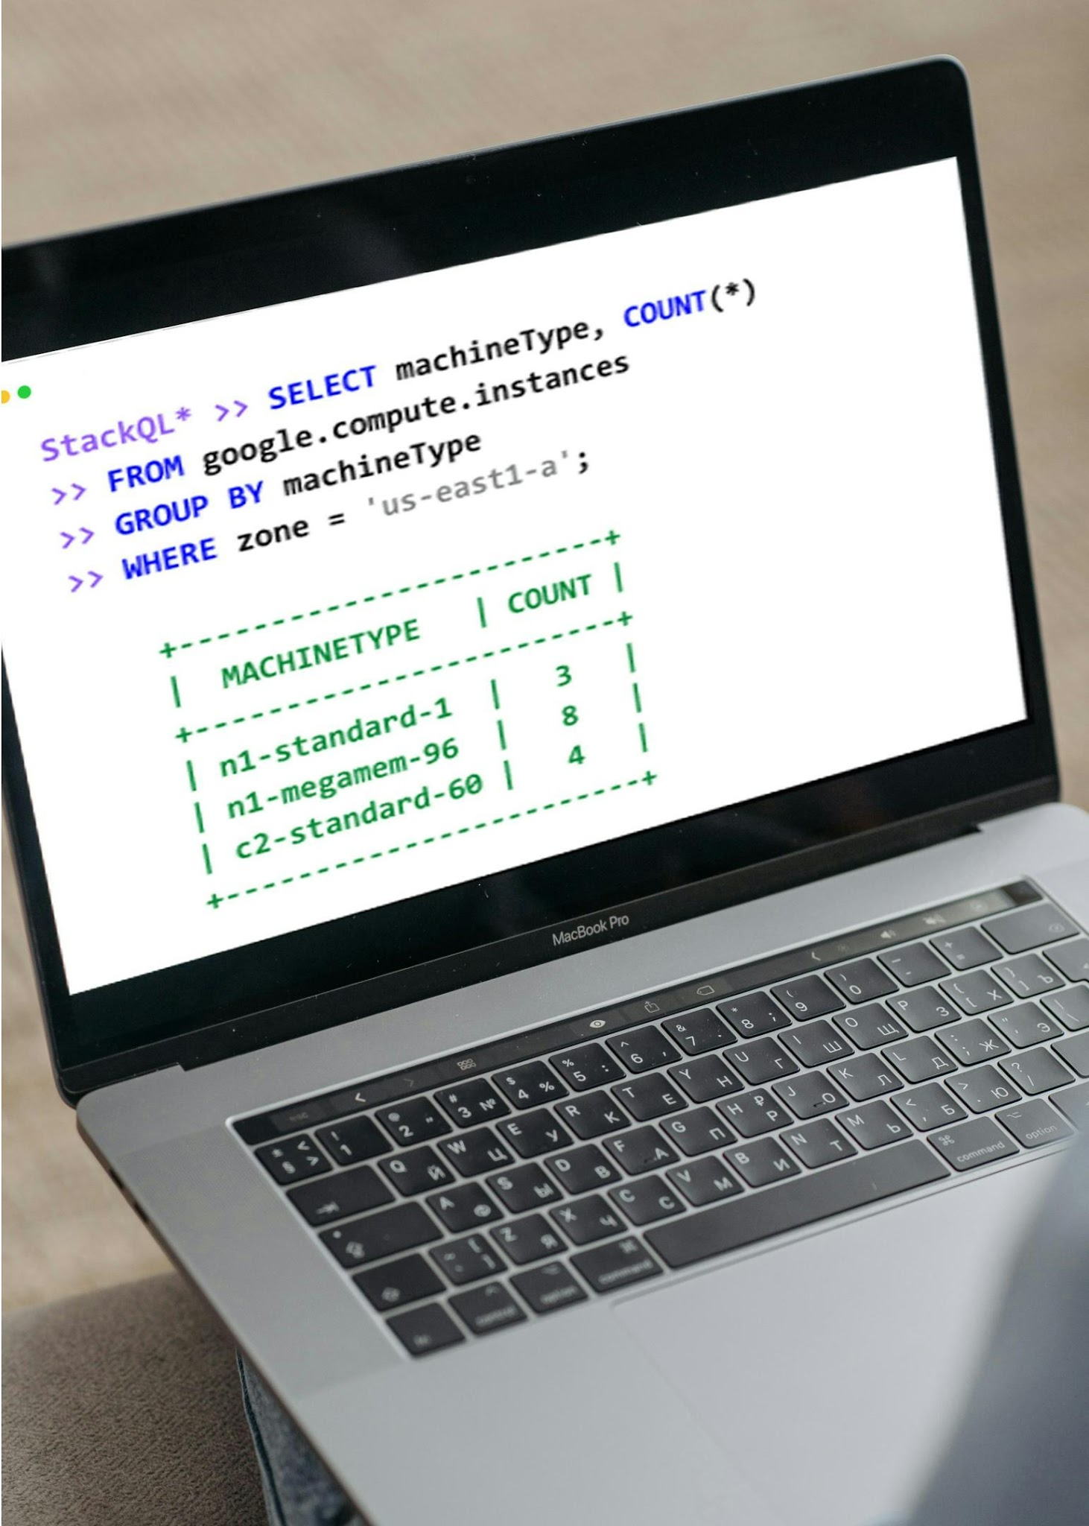


STACKQL >>
Unified Cross-Plane Analytics, Automation and IaC
Query and Interact in Real
Time using SQL
Seamless Integration with
Existing Systems
Analyst Friendly, Agent Native
CONFIGURATION-AS-DATA
INFRASTRUCTURE-AS-CONTEXT
STACKQL>>
Notes:
Cloud and SaaS providers as data sources accessed via SQL.
Query and change live state.
No server, no database, no state file: the engine calls the provider APIs at query time.

Slide 3

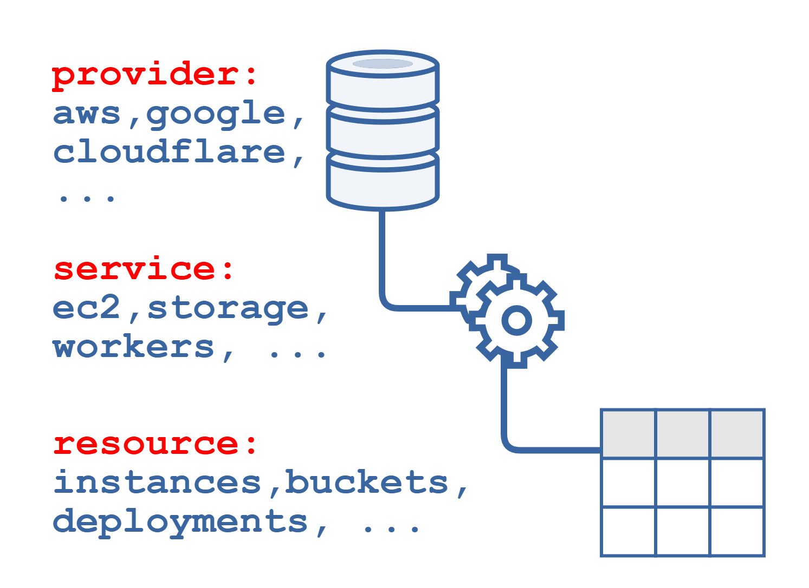
Cloud Providers as Data Sources
Open-Source intelligent API client
Protocol Agnostic
DAG planning for remote and local execution
SQL semantics for Cloud/SaaS Provider APIs
Relational algebra, analytics
CRUD, Discovery and Lifecycle Methods
STACKQL>>
Notes:
Providers are OpenAPI-derived interface documents pulled from a registry; 40+ providers, community extensible.
SELECT for reads, INSERT/UPDATE/REPLACE/DELETE for writes, EXEC for lifecycle methods.
The planner builds a DAG: remote calls where it must, local relational work (joins, aggregates, SQLite functions) where it can.

Slide 4




How to use StackQL
One execution engine. Multiple human/agent consumption patterns.
PATTERN |  | INTERFACE | USERS | KEY BENEFIT
 | Interactive Analytics | stackql shell stackql exec | Engineers, Analysts | Ad-hoc discovery, inventory
 | Application & Data Integration | stackql srv docker pull pystackql | Apps, BI Tools, Python Workloads | Application access to Cloud and SaaS APIs
 | Platform Automation | stackql-deploy Marketplace GitHub Actions | Platform & DevOps Teams | Declarative automation and IaC
 | Agentic Operations | MCP (uv, pip, npx, docker, mcpb) | AI Agents & Agent Frameworks | Context-aware cloud operations
STACKQL>>

Slide 5
AGENTIC PLATFORM OPS
Platform Engineering, XOps, and SRE in the Agent Era
STACKQL>>
Notes:
why does any of this matter for platform engineering, SRE, XOps?
Because agents are about to become writers to your estate, and the tooling assumes they are not.

Slide 6

IaC/PLATFORM OPS IN THE AGENT ERA
Agents AND humans
author changes.
Humans author the changes.
Changes at human timescales.
Changes at machine speed.
One writer per environment.
Multiple writers, at the same time.
Drift is an exception.
Drift is the default state.
STACKQL>>
Notes:
IaC was based upon four assumptions, all of which were reasonable ten years ago, now all inverted.
Humans authored the changes.
Changes happened at human timescales, which is to say minutes to days.
One writer per environment, enforced by review and state locking.
And drift was an exception, something you fixed and then went back to the steady state.
A state file is a snapshot of one writer's belief.
With multiple writers it is wrong by construction.

Slide 7
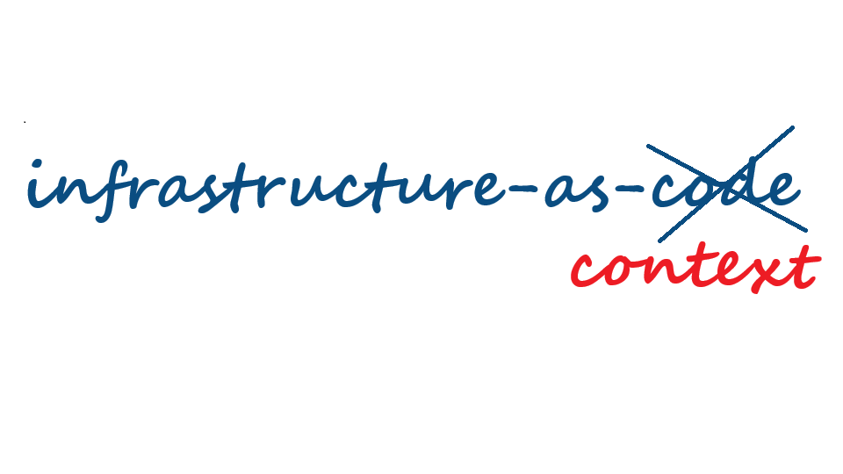
IaC IN THE AGENT ERA
STACKQL>>
Notes:
The agent's context has to be the running estate, not a plan file.

Slide 8
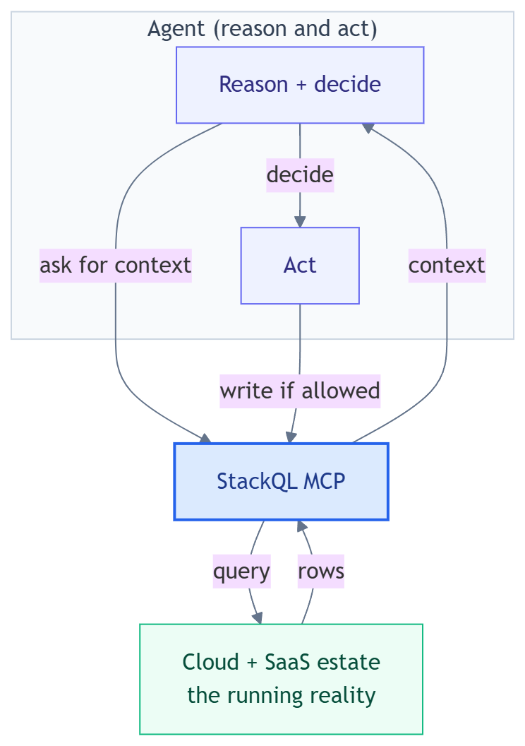
THE NEW CONTRACT
Agents need to query, reason about, and act on actual state.
Static state and state files are artefacts of slow infrastructure.
STACKQL>>
Notes:
with Infrastructure-as-Code: the intent lived in the code.
with Infrastructure-as-Context: agents need to query, reason about, and act on actual state.
Code does not disappear. It - along with the state file - just stops being the contract.

Slide 9
STACKQL MCP
The agent interface to the StackQL execution engine
STACKQL>>
Notes:
The agent interface to the engine. Same SQL, served over MCP.

Slide 10
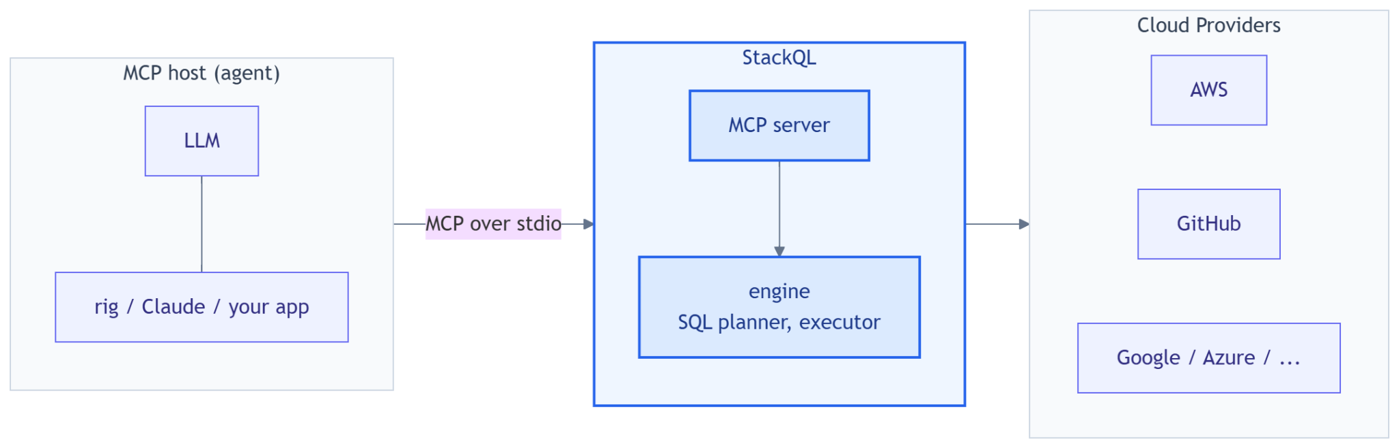
WHAT THE STACKQL MCP SERVER IS
Unified SQL surface over every cloud and SaaS provider.
STACKQL>>
Notes:
One MCP server, one SQL surface, every provider. Instead of N bespoke tool servers with N auth schemes.
Runs over stdio or HTTP; tonight the host is a small TypeScript agent on the Vercel AI SDK with an OpenAI model, but it is the same server Claude Desktop, Cursor, npx and uvx users run.
Credentials stay server-side in the process environment; the model never sees them.

Slide 11
STACKQL MCP TOOL SURFACE
One MCP, one set of tools, instead of 10s or 100s
Discovery: list_providers, list_services, list_resources, describe_resource, describe_method, list_methods, list_registry, pull_provider, server_info
Query (reads): run_select_query, validate_select_query
Change (writes): run_mutation_query, run_lifecycle_operation
changes gated through server modes: read_only (default), safe & delete_safe (uses elicitation), full_access
all tool use is logged by the stackql mcp server
STACKQL>>
Notes:
Discovery tools let the model drill provider -> service -> resource -> methods before writing SQL, so it does not guess table names.
Modes are a server-side contract: `read_only` refuses writes however the model is prompted; `safe` and `delete_safe` send an MCP elicitation request and wait for a human; a client that cannot answer gets a refusal. `full_access` is the explicit opt-in.
Every tool call is audited as JSONL (SQL, decision, duration; never result rows).

Slide 12
STACKQL-DEPLOY
Stateless IaC: the write path for agents
STACKQL>>
Notes:
The MCP server is how an agent reads. stackql-deploy is how it should write.
Open source, SQL-native IaC on the same engine. A manifest in YAML, resources as SQL files.
The one thing to remember: there is no state file.

Slide 13
STATE FILE-LESS IaC
Each resource is a handful of SQL queries against the live API.
exists?
SELECT: is it there
create
INSERT
resources/table_guardrails.iql
no
/*+ exists */
SELECT COUNT(*) AS count
FROM aws.dynamodb.tables
WHERE region = '{{ region }}'
AND table_name = '{{ table_name }}'
/*+ statecheck */
SELECT COUNT(*) AS count
FROM aws.dynamodb.tables
WHERE region = '{{ region }}'
AND table_name = '{{ table_name }}'
AND deletion_protection_enabled = true
/*+ update */
UPDATE aws.dynamodb.tables
SET DeletionProtectionEnabled = true
WHERE region = '{{ region }}'
AND table_name = '{{ table_name }}'
yes
statecheck?
SELECT: is it as declared
no
update
UPDATE
yes
exports
SELECT: values passed on
Run it twice: the second run changes nothing.
Run it after drift: it converges.
STACKQL>>
Notes:
A resource is a file of SQL with named anchors. This is the real file from tonight's demo.
exists: a SELECT. Is the thing there? If not, run create, an INSERT.
statecheck: a SELECT. Is it what the manifest says? If not, run update, then check again.
exports: a SELECT. Values the next resource needs, read from the provider, not from a file.
Nothing is remembered between runs. The provider is the state. So there is nothing to store, lock, import or repair, and nothing that can disagree with reality.
Honest caveat: no lock also means two writers can race. Idempotent assertions make a race converge instead of corrupt; they do not make it atomic.
Why this matters for agents: an agent, a pipeline and a human at 3am can all run the same build and get the same answer.

Slide 14
READ WIDE, WRITE NARROW
Patterns for agent access to the control and data planes.
READ any SELECT, no writes
StackQL MCP server in read_only mode
Discover, then query: providers are tables
Control and data planes in one interface
Credentials stay in the server process
Every statement lands in the audit log
WRITE only by running the stack
Its only write: stackql-deploy build
It never edits the manifest or the queries
Drift: re-run the stack as written
Rollout: one approved value, then re-run
Tuning: one value inside declared bounds
Policy in code, then a human approves
The agent decides when to ask.
The reviewed stack decides what changes.
STACKQL>>
Notes:
Two doors for an agent: one to look, one to change. They are different on purpose.
Read wide: any SELECT, through the MCP server in read_only mode. Control plane (what exists, how it is configured) and data plane (what is in it, what it is doing) through one interface. The server refuses writes, and the agent is not even given the write tools.
Write narrow: the agent cannot run a write statement, and it never edits the manifest or the queries. The one thing it can ask for is a stackql-deploy build of a stack that people wrote and reviewed. So the most it can do is make the cloud match what was already approved.
Drift, in the demo: someone changed something by hand. The build runs the stack as written and puts it back. No file changes.
Rollout, in the demo: one line in one small file, the release for that cell, moves to the release already approved for this rollout. The gate makes that edit, not the model, and only after a person says yes. Then the same build.
Tuning, not in tonight's demo: the rollout case with a different limit. The one value is something like a rate limit, and the limit is a range declared in the manifest, say 20 to 200. The agent moves it when conditions change; the gate checks the number against the range; then the same build.
A second way to get tuning, because the state check is a query: let it accept a range instead of one value. A build then leaves an in-range value alone and resets anything outside it. Drift inside the bounds is the agent doing its job; outside them it is an incident.
What is real: range and set checks run against live AWS today. What is not: a first-class "tunable" in the manifest. That is a pattern you write by hand, and an idea for the tool.
In front of all three: checks in code, then a human on the exact command, then an audit record.
If you want an agent to change what the stack says, that is a pull request, reviewed like any other change. It is not this path.

Slide 15
ONE DECLARATION, EVERY CELL
The demo: a release agent gates a three-region rollout.
stackql_manifest.yml + cells/*.env reviewed, in git, no state file
syd wave 0, canary
ap-southeast-2 Sydney
orders table DynamoDB
deletion protection on
release pointer SSM 1.5.0
pdx wave 1
us-west-2 Oregon
orders table DynamoDB
deletion protection on
release pointer SSM 1.4.0
fra wave 2, built on stage
eu-central-1 Frankfurt
orders table DynamoDB
deletion protection on
release pointer SSM 1.4.0
gate
gate
1 Build a cell from nothing, then again
2 One query: the whole rollout
3 Drift on the canary, out of band
4 The gate says no, without the model
5 The agent: query, converge, promote
STACKQL>>
Notes:
The demo estate. An orders service in three cells: Sydney, Oregon, Frankfurt. Each cell is one region and one rollout wave.
One manifest describes a cell. A small file per cell says where it is, which wave, which release. That is the whole declaration.
Each cell: a DynamoDB table with deletion protection, and a release pointer, a parameter that stands in for whatever your deploy flips.
Release 1.5.0 is on the canary. The rest are on 1.4.0. Frankfurt does not exist yet; I will build it in front of you.
Five beats: build a cell twice; read the whole rollout in one query; drift on the canary; the gate without the agent; then the agent.

Slide 16
DEMO
STACKQL>>
Notes:
Demo, about seven minutes. Runsheet: 11-26 Infracoders/demo/runsheet.md
1. scripts/build.sh fra, then again: create from nothing, then a no-op. No state file in the directory.
2. scripts/board.sh: three regions, two services, one statement.
3. The drift is already there (scripts/stage.sh): deletion protection off on Sydney's table.
4. npm run gate -- promote fra 1.5.0: declined by policy, wave order.
5. npm run agent: board, CloudTrail, converge syd (approve), promote pdx (approve), board again. Then npm run audit.
Fallback if the network or the model is down: npm run replay. Say it is a replay.

Slide 17
SAME INTERFACE, OTHER JOBS
Provisioning and SRE through one SQL surface.
Rollout gate in the demo
Is every cell in front of this wave what we declared?
stackql-deploy test
Posture sweep
Every table in every region without deletion protection.
aws.dynamodb.tables
Incident triage
What changed in the cells that are alarming, in the last hour?
aws.cloudtrail.events
Cost analysis
Spend by service this month, joined to its inventory.
aws.ce.cost_and_usages
Drift review
What drifted from the declaration, and who did it?
statecheck + cloudtrail
Environment cleanup
Every preview stack older than a day, torn down by its own declaration.
stackql-deploy teardown
STACKQL>>
Notes:
The rollout gate was one job. The interface is the same for the others; only the question changes.
Posture sweep: one statement across every region. Schedule it; alert on rows.
Incident triage: join what is alarming to what changed. CloudTrail is a table too; you saw the agent use it.
Cost analysis: Cost Explorer is a table. Join spend to the inventory that explains it, in the same query language as the fix.
3am drift review: what differs from the declaration, who changed it, converge or escalate.
Environment reaper: find the preview stacks older than a day and tear each down with its own declaration.
The point: the agent does not need a new tool per job. It needs SQL, discovery, and a narrow way to write.

Slide 18
WHAT TO TAKE HOME
Code declares intent.
A manifest and SQL. No state file to store, lock or go stale.
Context grounds the decision.
The live estate as data: query before you mutate.
Policy bounds the action.
A gate in code, then a human on the exact command.
stackql-deploy.io github.com/stackql
this demo github.com/stackql-labs/agentic-platform-engineering
STACKQL>>
Notes:
Code declares intent: a manifest and SQL, reviewed, in git. No state file.
Context grounds the decision: the agent, and the gate, query the live estate before anything changes.
Policy bounds the action: what can be written is decided in code and by a person, not by the model.
Everything from tonight is in the repo on the slide. stackql-deploy is open source.

Slide 19



CLOUD
COMPLIANCE
SECURITY
MCP
AUTOMATION
ASSURANCE
THANK YOU
STACKQL>>
stackql.io

